Slide 1
Chapter 6

Slide 2

Objectives
Vectors
Node based operations
Iterators
List ADT
STL
STL containers
Sequences

Slide 3
Vectors
List
Collection of n elements stored in a certain linear order
There is a first, second, third and so on elements
Range [0,n-1]
Index of an element is the number of elements that precede the element
A list that supports access to its elements by their indices is called an vector

Slide 4

Applications of Vectors
Direct applications
Sorted collection of objects (elementary database)
Indirect applications
Auxiliary data structure for algorithms
Component of other data structures

Slide 5
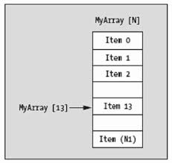
The Vector ADT
The Vector ADT extends the notion of an array
An element can be accessed, inserted or removed by specifying its index (number of elements preceding it)
An exception is thrown if an incorrect index is given (e.g., a negative index)
It is not mandatory that an array is used to implement a vector

Slide 6

The Vector ADT Methods
at (integer i): returns the element at index i without removing it
set (integer i, e): replace the element at index i with e
insert (integer i, e): insert a new element e to have index i
erase (integer i): removes element at index i
size (): returns the number of elements stored
empty (): indicates whether no elements are stored

Slide 7
Vector Example
Operation Output vector
insert(0,7) – (7)
insert(0,4) – (4, 7)
at(1) 7 (4, 7)
insert(2,2) – (4, 7, 2)
at(3) “error” (4, 7, 2)
erase(1) – (4, 2)
insert(1,5) – (4, 5, 2)
insert(1,3) – (4, 3, 5, 2)
insert(4,9) – (4, 3, 5, 2, 9)
at(2) 5 (4, 3, 5, 2, 9)
set(3,8) – (4, 3, 5, 8, 9)

Slide 8
Array-based Implementation for the Vector ADT
Uses a fix size array A of size N
A variable n keeps track of the size of the vector (number of elements stored) (n < N)
Operation at(i) is implemented in O(1) time by returning A[i]
A
0
1
2
i
n

Slide 9
Insertion
In operation insert(i, e), one needs to make room for the new element by shifting forward the n - i elements A[i], …, A[n - 1]
In the worst case (i = 0), this takes O(n) time
Algorithm insert(i, e)
for j = n − 1 to i do
A[j+1] ← A[j]
A[j] ← e
n ← n+1
V
0
1
2
i
n
V
0
1
2
i
n
V
o
0
1
2
i
n

Slide 10
Removal
In operation erase(i), one needs to fill the hole left by the removed element by shifting backward the n - i - 1 elements A[i + 1], …, A[n - 1]
In the worst case (i = 0), this takes O(n) time
Algorithm erase(i)
e ← A[i]
for j = i to n-1 do
A[j] ← A[j+1]
n ← n-1
return e
A
o
0
1
2
i
n
A
0
1
2
i
n
A
0
1
2
i
n

Slide 11
Performance of the Vector ADT
Method | Time
size() | O(1)
empty() | O(1)
at() | O(1)
set(i,e) | O(1)
insert(i,e) | O(n)
erase(i,e) | O(n)

Slide 12

Performance Improvement
If we use the array in a circular fashion, operations insert(i, e) and erase(e) can run in O(1) time if we relax the rule that an element with index i must be stored in the array at index i (for insertions and deletions at the beginning and end of the array)
insert(e)

Slide 13

Implementing an Array List using Extendable Arrays
Consider a vector implementation with an array
In an operation insert(i, e) operation, when the array is full, instead of throwing an exception, one can replace the array with one that is double the size or a multiple of the size (extendable array)
Allocate a new array B of capacity c*N (where c = 2, 3, …)
Copy A[i] to B[i] for i = 0, 1, 2, …. N -1
De-allocate A

Slide 14

Extendable Arrays
A
B
A
B
A
B

Slide 15
Extendable Array ADT
typedef int Elem; // base element type
class ArrayVector {
public:
ArrayVector(); // constructor
int size() const; // number of elements
bool empty() const; // is vector empty?
Elem& operator[](int i); // element at index
Elem& at(int i) throw(IndexOutOfBounds); // element at index
void erase(int i); // remove element at index
void insert(int i, const Elem& e); // insert element at index
void reserve(int N); // reserve at least N spots
// ... (housekeeping functions omitted) // copy constructor, destructor // assignment operator
private:
int capacity; // current array size
int n; // number of elements in vector
Elem* A; // array storing the elements
};
6.2

Slide 16
Extendable Array ADT Methods (1)
ArrayVector::ArrayVector() // constructor
: capacity(0), n(0), A(NULL) { }
int ArrayVector::size() const // number of elements
{ return n; }
bool ArrayVector::empty() const // is vector empty?
{ return size() == 0; }
Elem& ArrayVector::operator[](int i) // element at index
{ return A[i]; }
// element at index (safe)
Elem& ArrayVector::at(int i) throw(IndexOutOfBounds) {
if (i < 0 || i >= n)
throw IndexOutOfBounds("illegal index in function at()");
return A[i];
}
6.3

Slide 17
Extendable Array ADT Methods (2)
void ArrayVector::erase(int i) { // remove element at index
for (int j = i+1; j < n; j++) // shift elements down
A[j - 1] = A[j];
n--; // one fewer element
}
6.4

Slide 18
Extendable Array ADT Methods (3)
void ArrayVector::reserve(int N) { // reserve at least N spots if (capacity >= N) return; // already big enough Elem* B = new Elem[N]; // allocate bigger array for (int j = 0; j < n; j++) // copy contents to new array B[j] = A[j]; if (A != NULL) delete [] A;// discard old array A = B; // make B the new array capacity = N; // set new capacity
}
6.5

Slide 19
Extendable Array ADT Methods (4)
void ArrayVector::insert(int i, const Elem& e) {
if (n >= capacity) // overflow?
reserve(max(1, 2 * capacity)); // double array size
for (int j = n - 1; j >= i; j--) // shift elements up
A[j+1] = A[j];
A[i] = e; // put in empty slot
n++; // one more element
}
6.5
See Extendable Array Presentation on Blackboard

Slide 20
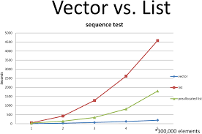
Proposition 6.2
Let V be a vector implemented by an extendable array, A
The total time to perform a series of n push operations starting from V being empty and having size N=1 is O(n)
Many push operations will occur in O(1) time
Others will occur in O(n) time

Slide 21
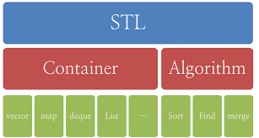
The STL Vector
The class vector is a STL container class
The header file <vector> - defines a template class for implementing a container (resizable array)
#include <vector>
using namespace std;
vector <type> myVector;

Slide 22
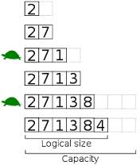
The STL Vector
Individual elements can be indexed using the [ ] operator or the at() method
at() performs boundary checking (throw exceptions)
STL vectors can be dynamically resized
When STL vectors go out of scope, the destructor automatically destroys the class objects
A number of useful methods that operate on the entire vector is provided
Copy all or part of a vector
Compare contents of two vectors
Insert and erase multiple elements

Slide 23
STL Operators
v[i] // accesses the element whose index is i
v1 = v2 // assigns a copy of v2 to v1
v1 == v2 // returns true if and only if v1 has the same values as v2, in the same order
v1 < v2 // returns true if and only if v1 is lexicographically less than v2
v1 is not equal to v2, v3 is not equal v4
v1 is less than v2, v3 is less than v4
v1 | 1 | 1
v2 | 1 | 1 | 1
v3 | 1 | 1 | 1
v4 | 1 | 2 | 0

Slide 24
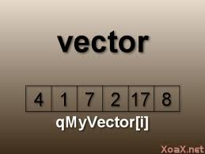
The STL Vector Methods (1)
vector (n)
Constructs a vector for n elements – if n is not specified, an empty vector is created
size()
Returns the number elements in the vector
empty()
Returns true if the vector is empty else false
resize(n)
Resize the vector so it has space for n elements
Can reduce the size of the vector
reserve (n)
Request that allocated storage space be large enough to hold n elements (does not affect the vector’s size)

Slide 25
The STL Vector Methods (2)
capacity ( )
returns the current capacity of the vector
operator[i]
Returns a reference to the i^{th} element
at(e)
Same as v[i] with boundary checking
front()
Returns a reference to the first element
back()
Returns a reference to the last element
push_back(value)
Append value at of the end of the vector (size is increased by 1)
pop_back(value)
Remove the vector’s last element (size is decreased by 1)

Slide 26
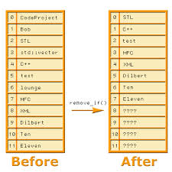
The STL Vector Web Site
For all the vector constructors and methods
http://www.cplusplus.com/reference/vector/vector

Slide 27
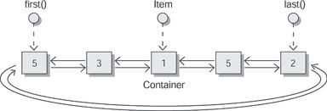
Lists
Using an index is not the only way to access elements
One can use nodes instead of indices to access a list
If a list is implemented as a singly or doubly linked list, it could be more efficient to use a node instead of an index to access and update a list

Slide 28
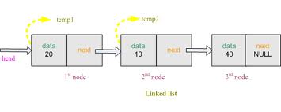
Node-Based Operations
Given a singly or doubly linked list
Define methods for the linked list that take nodes as parameters and return nodes
Much more efficient then traversing the linked list

Slide 29
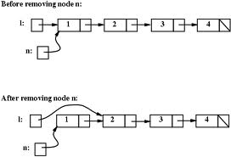
Removing a Node
It would be great to define a remove (v) method that removes an element in O(1) time
Goes directly to the location of the node stored at node v of the list and removes the node from the linked list
Via an update of the next and previous pointers
Can be accomplished by the use of pointers

Slide 30

Inserting a Node
It would be great to define an insert (v,e) method that inserts an element e into the list which specifies the node v before which the new node should be inserted that runs in O(1) time
The new node is simply “linked” in
Can be accomplished by the use of pointers

Slide 31

Containers and Positions
One can view a list as an instance of a more general class of objects called containers
Container
A data structure that stores any collection of elements
Elements of a container can be arranged in a linear order

Slide 32

Position ADT (1)
The Position ADT is associated with a particular container
Models the notion of place within a data structure where a single object is stored
Provides a unified view of diverse ways of storing data, such as
A cell of an array
A node of a singly or doubly linked list
A node on a tree

Slide 33

Position ADT (2)
The Position ADT
Allows one to access individual elements
Contains only one method: element ()
Returns a reference to the element stored at this position
Given a position p, the associated element can be accessed by *p (overloaded operator)

Slide 34
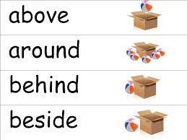
Position ADT (3)
A position is always defined relatively
A position q is always after some position p or before some position r (unless q is the first or last position in a container)

Slide 35
A List Container
Cat
Coyote
Dog
Monkey
p
q
r
s
The positions in the current order are p, q, r, s

Slide 36
Positions
Position q which is associated with element e (node)
Does not change even if the index of e changes in the container unless the e is explicitly removed
If the associated node is removed, then q is invalidated
Position q does not change if one replaces or swaps element e stored at q with another element
Lexus
Acura
Chevy
Ford
A
B
C
D
Ford
Chevy
Acura
Lexus
A
B
C
D

Slide 37
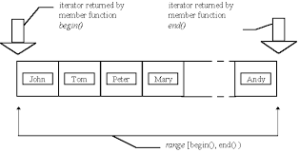
Iterators

Slide 38
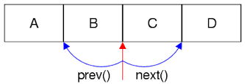
Iterators
An iterator is an object that enables one to traverse through a container
Extends the concept of the Position ADT by adding a traversal capability
Abstracts the process of scanning through a collection of elements (forward and backward)
An iterator returns the elements according to the linear ordering
Provides a scheme to access all the elements of a collection of objects independent of the its organization

Slide 39
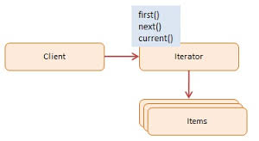
More on Iterators
An iterator encapsulates the concepts of “place”, “next”, and previous for a collection of objects
The increment operator (++) is overloaded to provide the forward capability
The decrement operator (--) is overloaded to provide the backward capability
Implement using a doubly linked list

Slide 40
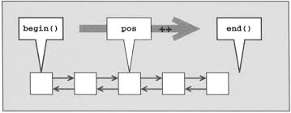
Traversing a Container
An iterator behaves like a pointer to an element
*p: returns the element referenced by this iterator
++p: advances to the next element
Each container provides two special iterator values
begin: refers to first position
end: refers to an imaginary position that lies just after the last node of the container

Slide 41
Special Iterators for List L
Cat
Coyote
Dog
Monkey
L.begin()
L.end()

Slide 42
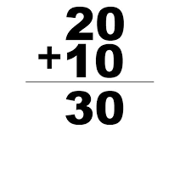
Iterating Through a Container
Let C be a container and p be an iterator for C
for (p = C.begin(); p != C.end(); ++p)
loop_body
Example: (with an STL vector)
typedef vector<int>::iterator Iterator;
int sum = 0;
for (Iterator p = V.begin(); p != V.end(); ++p)
sum += *p;
return sum;

Slide 43
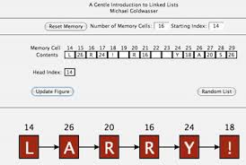
List ADT Methods (1)
Supports the following methods for list L and an iterator p for the list
begin() : returns an iterator to the first element of L, same as end() if L is empty
end() : returns an iterator referring to an imaginary element just after the last element of L
insertFront(e): inserts a new element e into L as the first element
insertBack(e): inserts a new element e into L as the last element

Slide 44
List ADT Methods (2)
insert (p,e): inserts a new element e into L before position p in L
eraseFront(): removes the first element of L
eraseBack(): removes the last element of L
erase(p): removes from L the element at position p;
Invalidates p as a position
Additional methods
size(): returns the number of elements stored
empty(): indicates whether no elements are stored

Slide 45

Error Conditions
p will be invalid if
p was never initialized or was set to a position in a different list
p was previously removed from the list
Attempting to access a position beyond the end position
Attempt to perform ++p where p=L.end()

Slide 46
List ADT Example
Operation Output List
insertFront(8) – (8)
p=begin() p : (8) (8)
insertBack(5) - (8,5)
q=p;++q q : (5) (8,5)
p==begin() true (8,5)
insert (q,3) – (8,3,5)
*q=7 – (8,3,7)
insertFront(9) – (9,8,3,7)
eraseBack() – (9,8,3)
erase(p) – (9,3)
eraseFront() – (3)

Slide 47

Applications of the list ADT
A program that models several people playing a game of cards
Each hand can be modelled as a list
People tend to arrange their cards in order of suit
Inserting and removing cards could be implemented using the list ADT functions by the natural ordering of the suits
A text editor could be modeled using the list ADT since all updates are relative to a cursor
The cursor represents the current position in a list

Slide 48

Implementing the List ADT
Use a doubly link list
Create a Node class
Store the elements
Create an Iterator class
Accesses/modifies the elements
Traverses the list
Create a NodeList class using composition
Incorporates Node and Iterator objects

Slide 49
Struct Node
struct Node { // a node of the list
Elem elem; // element value
Node* prev; // previous in list
Node* next; // next in list
};
6.6

Slide 50
Iterator Class
class Iterator { // an iterator for the list
public:
Elem& operator*(); // reference to the element
bool operator==(const Iterator& p) const; // compare positions
bool operator!=(const Iterator& p) const;
Iterator& operator++(); // move to next position
Iterator& operator--(); // move to previous position
friend class NodeList; // give NodeList access
private:
Node* v; // pointer to the node
Iterator(Node* u); // create from node
};
6.7

Slide 51
Iterator Class Methods
NodeList::Iterator::Iterator(Node* u) // constructor from Node*
{ v = u; }
Elem& NodeList::Iterator::operator*() // reference to the element
{ return v->elem; }
// compare positions
bool NodeList::Iterator::operator==(const Iterator& p) const
{ return v == p.v; }
bool NodeList::Iterator::operator!=(const Iterator& p) const
{ return v != p.v; }
// move to next position
NodeList::Iterator& NodeList::Iterator::operator++()
{ v = v->next; return *this; }
// move to previous position
NodeList::Iterator& NodeList::Iterator::operator--()
{ v = v->prev; return *this; }
6.8

Slide 52
NodeList Definition
typedef int Elem; // list base element type
class NodeList { // node-based list
private:
// insert Node declaration here...
public:
// insert Iterator declaration here...
public:
NodeList(); // default constructor
int size() const; // list size
bool empty() const; // is the list empty?
Iterator begin() const; // beginning position
Iterator end() const; // (just beyond) last position
void insertFront(const Elem& e); // insert at front
void insertBack(const Elem& e); // insert at rear
void insert(const Iterator& p, const Elem& e); // insert e before p
void eraseFront(); // remove first
void eraseBack(); // remove last
void erase(const Iterator& p); // remove p
// housekeeping functions omitted...
6.9

Slide 53
NodeList Data Members
private: // data members
int n; // number of items
Node* header; // head-of-list sentinel
Node* trailer; // tail-of-list sentinel
};
...
6.9 continued
See code fragments 6.10 – 6.12

Slide 54
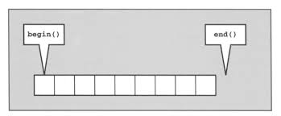
Performance Consideration with Iterators
All operations run in O(1) time
Except for the destructor, copy constructor, and the assignment operator
O(n)

Slide 55
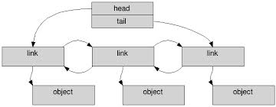
The STL List
list is a STL container class
The header file <list> - implemented using a doubly linked list
#include <list>
using namespace std;
list <type> myList;

Slide 56

The STL List Methods (1)
list (n)
Constructs a list for n elements
If n is not specified, an empty list is created
size()
Returns the number elements in the list
front()
Returns a reference to the first element in the list
back()
Returns a reference to the last element in the list

Slide 57

The STL List Methods (2)
push_front(e)
Insert a copy of e at the beginning of the list
Equivalent to the list ADT’s insert_Front(e)
push_back(e)
Insert a copy of e at the end of the list
Equivalent to the list ADT’s insert_Back(e)
pop_front()
Remove the first element of the list
Equivalent to the list ADT’s erase_Front()
pop_back()
Remove the last element of the list
Equivalent to the list ADT’s erase_Back ()

Slide 58
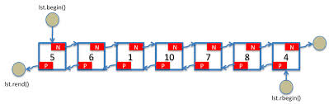
The STL List Web Site
For all the list constructors and methods
http://www.cplusplus.com/reference/list/list/

Slide 59
STL Containers Summary
STL Containers
<vector> - defines a template class for implementing a container (resizable array)
<stack> - container with the last-in, first-out access
<queue> - container with the first-in, first-out access
<deque> - double ended queue
<list> - doubly linked list
<iterator> - defines a template for defining manipulating iterators
<priority_queue> - queue order by value
<set> - set
<map> - associative array (dictionary)

Slide 60
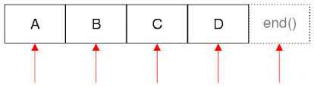
STL Iterators
Different containers organize data in different ways
STL iterators provide a uniform method to access the corresponding data independent of the underlying structure

Slide 61
STL Iterators - 2
Every STL container class has a corresponding iterator class
*p yields a reference to an associated element
++p or p++ advances p to the next element
begin() and end() methods are defined as follows
Cat
Coyote
Dog
Monkey
V. begin()
V. end()

Slide 62

Using Iterators
Most (including list) STL container iterators provide the capability of moving forwards and backwards
--p or p-- returns a reference to the previous element (bidirectional iterator)
The vector and deque containers allow for adding and subtracting and integer to an iterator (random access iterator)
For example:
p + 4 is valid

Slide 63

Traversing a Vector without an Iterator
The following function is valid for the vector container class
int vectorSum1(const vector<int> & V) {
int sum = 0;
for (int i = 0; i< V.size(); i++)
sum += v[i];
return sum;
}
This method only works for STL containers where the elements can be accessed efficiently using indices

Slide 64

Using Iterators
The following function is valid for all STL container classes
Not just vectors
int vectorSum2(vector<int> V) {
typedef vector<int>::iterator Iterator;
int sum = 0;
for (Iterator p = V.begin(); p != V.end(); ++p)
sum += *p;
return sum;
}

Slide 65
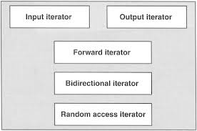
Const Iterators - 1
In example vectorSum2, the vector is passed by value (vector<int> V) by value (or copy)
Not efficient
It is generally more efficient to pass a const reference as v (const vector<int>& V)
Requires a const iterator

Slide 66

Const Iterator Example
int vectorSum3(const vector<int>& V) {
typedef vector<int>::const_iterator ConstIterator; int sum = 0;
for (ConstIterator p = V.begin(); p != V.end(); ++p)
sum += *p;
return sum;
}
Container’s values cannot be modified

Slide 67
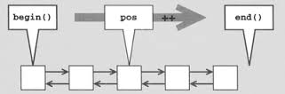
STL Iterator-Based Container Methods
STL iterators provide an uniform way to access elements using iterators as arguments
Many of the member functions and predefined algorithms use iterators as their arguments

Slide 68
STL Methods that use Iterators as Arguments (1)
Let p and q be iterators from the same container
Let V be an STL container
Let e be an object of this container class
vector (p,q): construct a vector by iterating between p and q
Copying each of these elements into the new vector

Slide 69
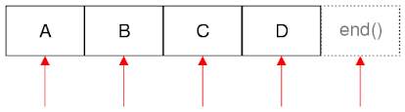
STL Methods that use Iterators as Arguments (2)
assign (p,q): delete the contents of V, and assigns its new contents by iterating between p and q
Copying each of these elements into the new vector
insert (p,e): insert a copy of e prior to the position given by the iterator p and shift the corresponding elements one position to the right
O(n) depending on the container

Slide 70
STL Methods that use Iterators as Arguments (3)
erase (p): remove and destroy the element of V at positon p and shift the corresponding elements one position to the left
erase (p,q): iterate between p and q, removing and destroying all these elements and shifting subsequent elements to the left to fill the gap
O(n) depending on the container
clear (): deletes all the elements of V
http://www.cplusplus.com/reference/iterator/

Slide 71

More on Iterators (1)
STL list and deque use a doubly linked list so there is no need to shift element during the insert or delete
The vector, list, and deque containers are called sequence containers since they explicitly store elements in sequential order
The set, multiset, map, multimap containers support all the fore-mentioned methods except for assign(p,q)
Called associated containers since elements are typically accessed via an associated key

Slide 72

More on Iterators (2)
In the constructor and assignment methods, the iterators p and q do not have to be from the same type of container
Must be of the same base type
Example
Copying a list to a vector
Suppose that L is an STL list container of integers, then one can create a copy of L in the form of an STL vector, V as follows:
list <int> L; //an STL list of integers //…
vector <int> V(L.begin(), L.end()); // initializes V to be a copy of L

Slide 73
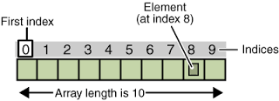
More on Iterators (3)
Initializing a vector from an array
int A[ ] = {2, 5, 1, 6, 9};
…
vector <int> V(A, A+5); // V = (2, 5, 1, 6, 9)

Slide 74

STL Vectors and Algorithms (1)
STL provides many algorithms
One needs to #include <algorithm>
All operations apply to [p,q)
sort (p,q) – sort the elements in the range [p,q) in ascending order
find(p,q,e) - returns an iterator to the first element equal to e between [p,q), if e is not found, q is returned
random_shuffle(p,q) - shuffles the values between [p,q) randomly

Slide 75

STL Vectors and Algorithms (2)
reverse(p,q) - reverses the elements between [p,q)
min_element (p,q) – returns an iterator to the minimum element in the range [p,q)
max_element (p,q) – returns an iterator to the maximum element in the range [p,q)
for_each(p,q,f)– apply the function f to the elements in the range [p,q)
See example algorithm1.cpp

Slide 76
Sequences

Slide 77

Sequences
The Sequence ADT is a basic, general-purpose, versatile data structure for storing an ordered collection of elements
Generalizes the vector and list ADTs
Provides access to elements via indices (like vectors) and positions (like lists)

Slide 78

Sequence ADT Bridge Methods
Relates indices and positions
atIndex(i): returns the position of the element at index i
indexOf(p): returns the index of the element at position p

Slide 79

Linked List Implementation
A doubly linked list provides a reasonable implementation of the Sequence ADT
All the list methods run in O(1) time
The methods atIndex() and indexOf() can be implemented from the vector ADT
Require searching from header or trailer while keeping track of indices; hence, run in linear time

Slide 80
Implementing the Sequence ADT via an Array
A pointer is stored in an array that points to an object
Object consists of an index i and the element e associated with p
0
JFK
1
PVD
2
SFO
A
0
1
2
3
4
n-1

Slide 81
Adding an Element to the Sequence
When a new element is added
The array is scanned to update the indices during an addition or deletion
0
JFK
1
BWI
2
PVD
3
SFO
A
0
1
2
3
4
n-1

Slide 82
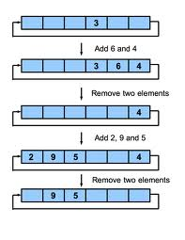
Array Implementation Performance
The insertFront(), insert, and erase take O(n) time
Elements must be shifted
If a circular array is used
The insertFront() runs in O(1)

Slide 83
Array-based Implementation using a Circular Array
elements
One uses a circular array storing positions
Indices f and l keep track of first and last positions
0
1
2
3
positions
S
f
l

Slide 84
Performance Comparison
Method | Circular Array | List
size(), empty() | O(1) | O(1)
atIndex(i), indexOf(p) | O(1) | O(n)
begin(), end() | O(1) | O(1)
*p, ++p, --p | O(1) | O(1)
insertFront(e), insertBack(e) | O(n) | O(n)
erase(p),insert(p,e) | O(n) | O(1)

